Slide 1
Data Structure
Lab Session #11:
Searching 2
U Kang
Seoul National University

Slide 2
Goals
Implement both Open and Closed Hash Table
Fill in the following methods in HashTable.java.
public void hashInsert(Key k, E r);
public E hashSearch(Key k);
public E hashRemove(Key k);
public void changeToClosed();
public void hashPrint();
Use the implemented interface and classes.
Dictionary, HashDictionary, and KVpair.
Print the sample output corresponding to the sample input.

Slide 3
Notice
After implementing “HashTable”, check if your program works well.
Check sample input and output files from the ‘testcase’ folder.
Test your program by using it.
When you finish implementing the program, you can leave.
But, you need to stay for at least an hour.
Check your attendance.

Slide 4
Build a project
Download the project for this lab from eTL.
Extract the project, and open it in IntelliJ.
See the slide of 1st lab session to check how to open the project in IntelliJ.

Slide 5
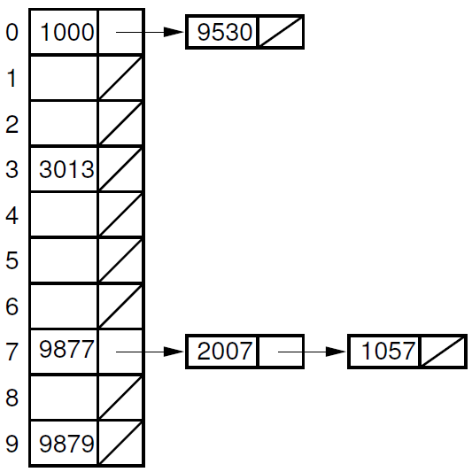
Open Hashing
Review Lectures 21 & 22
Open hashing (also called ‘separate chaining’)
Collisions are stored outside the table
Limitation: some slots in the table may not be used

Slide 6
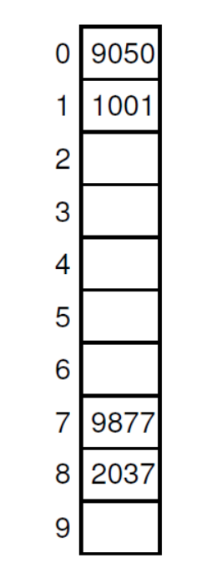
Closed Hashing
Review Lecture 21 & 22
Closed hashing with linear probing
Collisions are stored inside the table
Linear probing: insert a colliding value into the next available slot in the table
Insertion order:
1001, 9050, 9877, 2037
“Linearly probed”

Slide 7
I/O Specification (1)
public void hashInsert(Key k, E r);
Input form | Output form
insert (key) (value) | -
Description
Inserts a record of ((key), (value)). (key) is an integer and (value) is a string not containing spaces. Assumes there is no insertion of records with duplicate keys.
Sample Input | Sample Output
insert 1 apple1 | -

Slide 8
I/O Specification (2)
public E hashSearch(Key k);
Input form | Output form
find (key) | FIND: ((key), (value))
Description
Finds a record with (key). Does not change the table. Assumes there is no query for a non-existing key.
Sample Input | Sample Output
find 1 | FIND: (1, apple1)

Slide 9
I/O Specification (3)
public E hashRemove(Key k);
Input form | Output form
remove (key) | REMOVE: ((key), (value))
Description
Removes a record with (key). Assumes there is no query for a non-existing key.
Sample Input | Sample Output
remove 1 | REMOVED: (1, apple1)

Slide 10
I/O Specification (3)
public void changeToClosed();
Input form | Output form
change | -
Description
Changes open hashing formatted table to closed hashing table. * Check sample output (page 11) to see how it should be changed. Hint: use hashRemove()
Sample Input | Sample Output
change | -

Slide 11
I/O Specification (3)
public void print();
Input form | Output form
print | PRINT HASH: ((key), (value))…
Description
Prints elements in hash table with keys and values in order It should be able to print both open and closed hashing table
Sample Input | Sample Output
print
PRINT HASH:
(1, apple1) (111, apple3)
(2, banana1) (22, banana2)
PRINT HASH:
(1, apple1)
(2, banana1)
(111, apple3)
(22, banana2)

Slide 12
Sample Input & Sample Output
<Sample Input>
<Sample Output>
insert 1 apple1
insert 11 apple2
insert 111 apple3
insert 2 banana1
insert 22 banana2
print
find 11
find 2
remove 11
remove 2
find 111
find 22
print
change
print
quit
PRINT HASH: (1, apple1), (11, apple2) (111, apple3) (2, banana1) (22, banana2)
FIND: (11, apple2)
FIND: (2, banana1)
REMOVE: (11, apple2)
REMOVE: (2, banana1)
FIND: (111, apple3)
FIND: (22, banana2)
PRINT HASH: (1, apple1) (111, apple3) (2, banana1) (22, banana2)
PRINT HASH: (1, apple1) (2, banana1) (111, apple3) (22, banana2)

Slide 13
Questions?

